Slide 1
How-to slides
Brief explanation of the
Boehringer Ingelheim PPT master
Version 2.1, August 2026

Slide 2
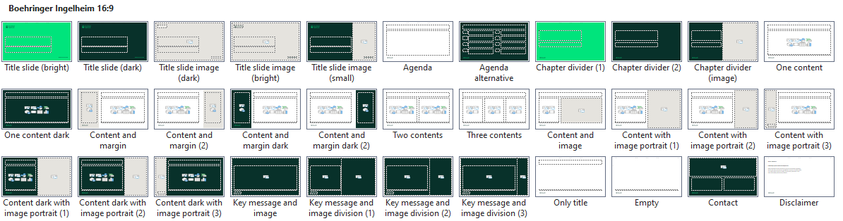

The slide master for Boehringer Ingelheim contains 33 slide layouts
Slide layouts.
Slide layouts are defined page types that contain preformatted placeholders of various types. These defined slide types provide a basis on which presentations can be quickly built.
For example, there are fixed placeholders for the slide title and pictures.
The size and position of these placeholders is always fixed. If something should accidentally slip out of place: The “Reset” function puts all placeholders back in the right place.

Slide 3

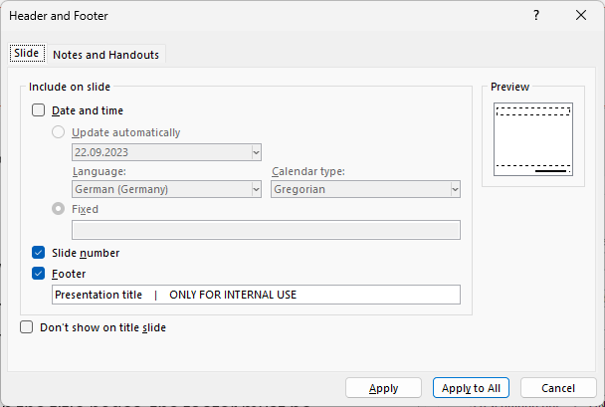

Confidentiality notice in the footer
        The confidentiality notice is integrated into the footer.
        This has the advantage that the confidentiality notice can be controlled centrally with one click via the “Header and footer” command in the “Insert” menu (“Apply to All”).
        Please note that on the title slides, the footer must be adjusted separately afterwards: delete “Presentation title | “ in the footer and choose “Apply” (not “Apply to All”).
        It is strongly recommended to make the entry only at the end of editing the entire presentation.

Slide 4
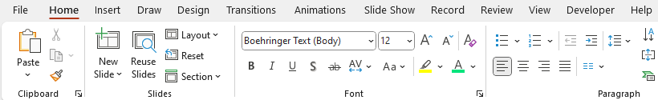

Working with text levels
Text levels.
To quickly format texts, use the text levels set up in the master text field. To set the text level, use the “Increase list level” or “Decrease list level” commands under the “Home” tab.
In the text levels 1 to 4 the defined font size is 16 pt.
In the first text level dots are defined as bullets.
If you need the text as continuous text, click on the Bullets
tool to deactivate bullets (and on it again to activate it)
Text levels 2 to 4 are further indented by a defined amount
compared to the respective previous one
Starting from text level 5, the font size is defined as 12 pt.
Level 5 starts again without indentation, levels 6 to 8 again have corresponding defined indentations, level 9 is the same as level 8
1
First level
  Second level
    Third level
      Fourth level
        Fifth level
          Sixth level
            Seventh level
              Eighth level
                Ninth level
16 pt.
2
1
2
12 pt.

Slide 5
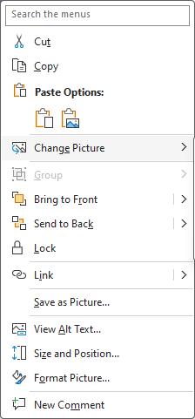
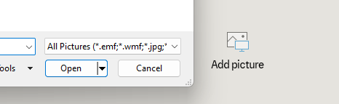
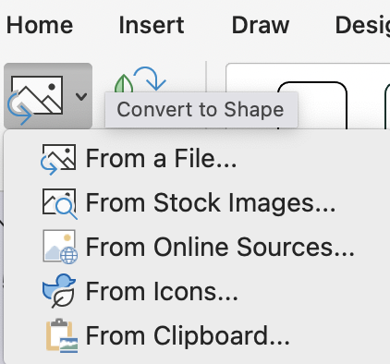
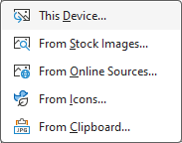
How to work with picture placeholders
        Inserting pictures.
        With picture placeholder, inserting pictures works especially easily.
        You can click the center icon in the picture placeholder and then insert a picture of
        your choice.
        If the button is covered by another placeholder, proceed as follows:
        Click on the placeholder
        for pictures
        Open the menu “Graphics Format”
        Choose “Change Graphic” and then the corresponding source where
        the picture is located
        Now the image has
        been loaded into the
        placeholder
        Change Pictures.
        Replace an existing picture by highlighting it with the right mouse button and choosing “Change picture” in the pop-up menu.
        Licensed images and illustrations
        for usage are available here:
        brand.boehringer-ingelheim.com
        Images | Illustrations | Icons

Slide 6
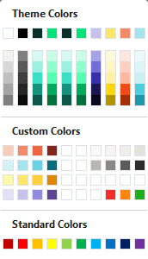
How to use the correct colors
Theme Colors
PowerPoint color palette.
Please use only the “Theme colors” and the “Custom Colors”
Do not use the gradations below the design colors and not the standard colors. These were created automatically by PowerPoint and are not CD-compliant.
1
2
Background
Text
Accent colors
Automatic diagram color sequence
Custom Colors
Light Red
Red
Medium Red
Dark Red
Gray 1
Light Gray
Gray 3
Warm Gray
1
Light Blue
Blue
Medium Blue
Dark Blue
Gray 5
Gray 6
Gray 7
Gray 8
2
Light Yellow
Yellow
Medium Yellow
Dark Yellow
1
Light Violet
Violet
Medium Violet
Dark Violet
Signal
Red
Signal Yellow
Signal Green
Signal colors
2

Slide 7
Title of the presentation
(in 1-2 lines)
An optional subtitle can be placed here
  Author | Date | Place

